Slide 1
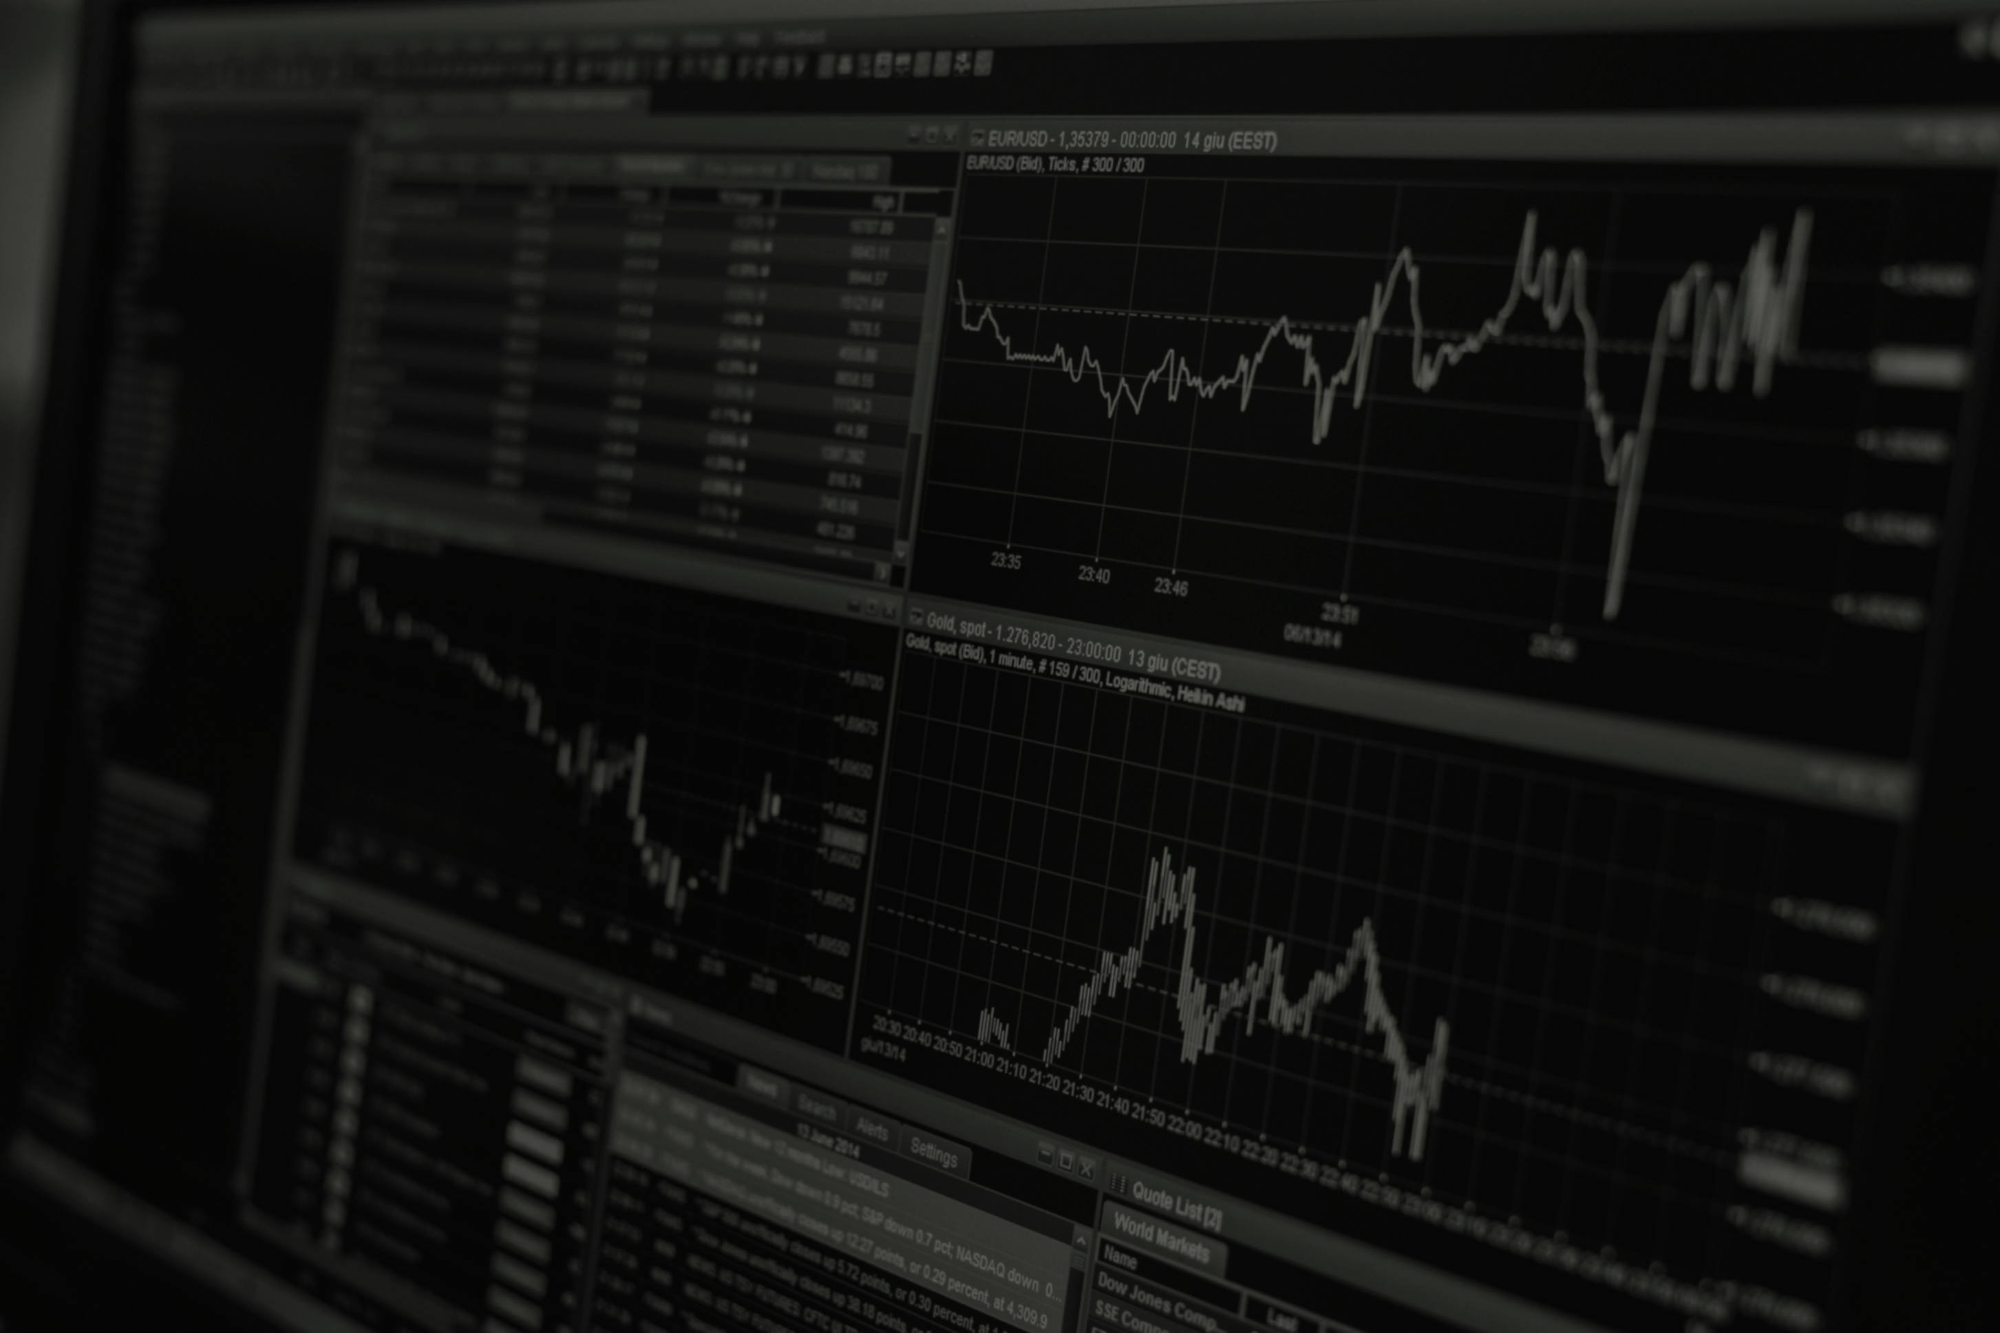
PORTFOLIO OPTIMIZATION USING RL
NAGA JASWANTH
HARI CHARAN
12240570
12240360

Slide 2
PROBLEM STATEMENT
In the world of stock markets, Optimising portfolios creates a challenge for traders in order to maximize their profits while minimizing risks. Traditional approaches often depend on static models and heuristics, which may not be suitable for dynamic markets. Hence, it is really important to find new innovative solutions that can use advanced technologies to optimize portfolios effectively. One such technology is Reinforcement Learning. The task is to develop a reliable portfolio optimization framework adapted specifically for traders using reinforcement techniques like Q-Learning.

Slide 3
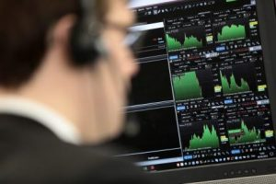
OVERVIEW
The goal of this project is to perform trade analysis on the historical stock market data of a set of stocks and optimize the financial portfolio of an investor.
This Photo by Unknown Author is licensed under CC BY-NC

Slide 4
METHODLOGY
DATA COLLECTION AND PREPROCESSING
PRICE MOVEMENT PREDICTION FOR SINGLE STOCK USING LSTM
PORTFOLIO OPTIMIZATION USING DQN

Slide 5
DATA PREPARATION
Dataset is obtained from NASDAQ and Yahoo Finance, containing Open, High, Low and Close values by default.
Technical Indicators like RSI, EMA, Stochastic Oscillator, etc., are added.
Target column contains on day difference between close prices.
Data is then scaled using Min Max Scaler.
Finally data is split into train and test samples at 0.8 ratio.

Slide 6
LSTM PREDICTION
A feed forward neural network fails to predict stock prices due to variable input sizes and non retaining of memory.
Solution : RNN
Drawback : Vanishing / Exploding Gradient.
LSTM (Long Short-Term Memory) networks employ a complex architecture and overcome drawbacks of RNNs.
Price trends are forecasted using data of certain lookback period.

Slide 7
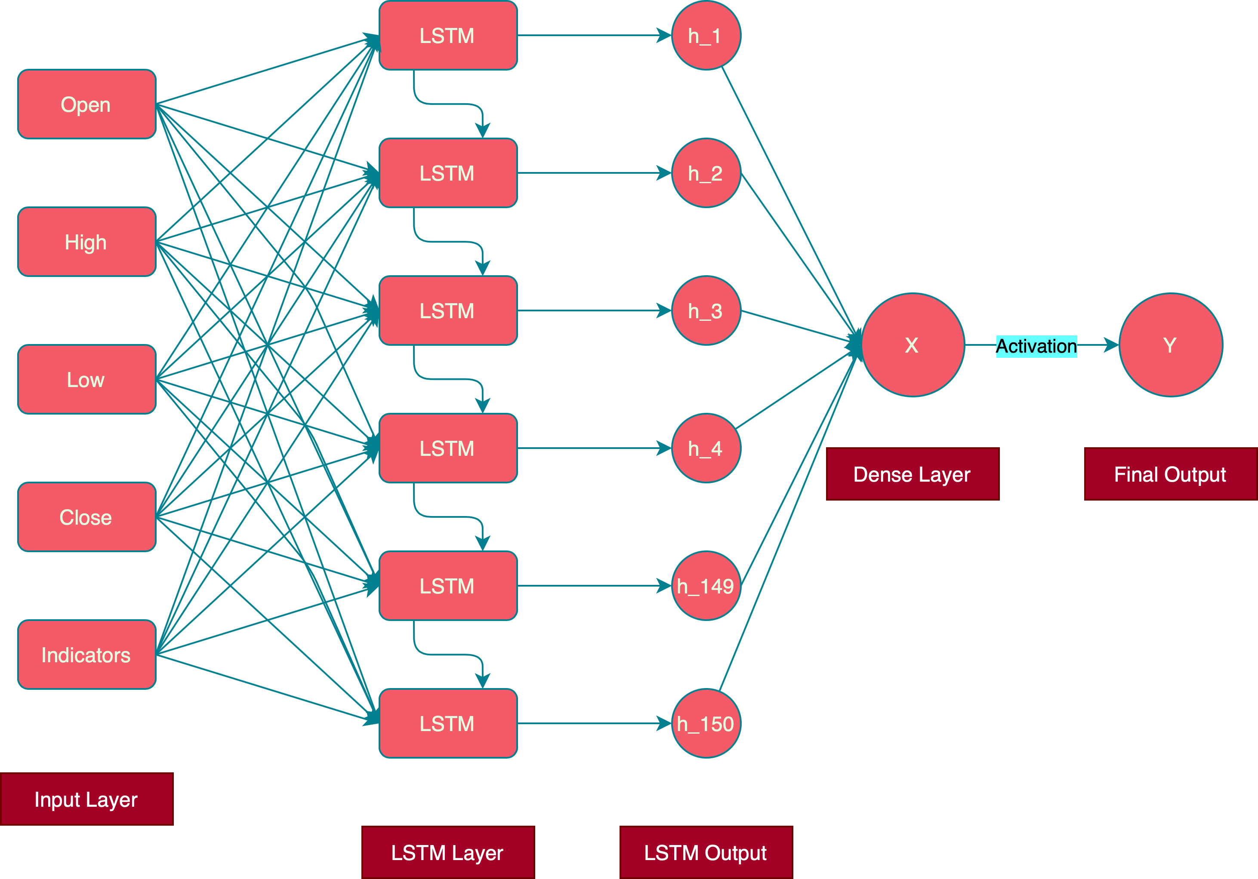
LSTM NEURAL NETWORK

Slide 8
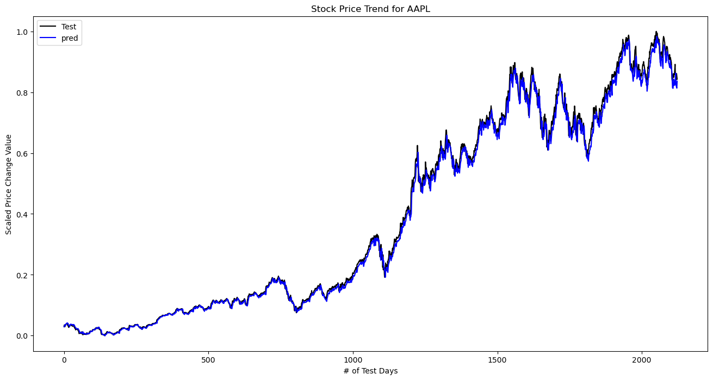
SAMPLE PREDICTION

Slide 9
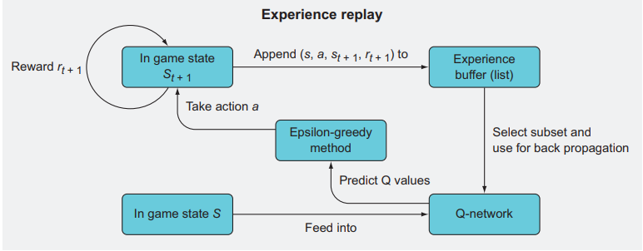
DEEP Q NETWORK
In the DQN framework, the Q- function is approximated by a feed forward fully connected neural network, for calculating the expected rewards for each action at the state.
Based on these Q values, optimal actions at a given state are determined.
Picture taken from book Deep Reinforcement Learning in Action

Slide 10
WORKING OF DQN
Object | Usage |  | Representation
State Space | Scaled one day difference of close prices for the set of stocks. |  | Vector of length k
Actions | Optimal actions to take for each stock based on Q-values. | 0 => Hold
 |  | 1 => Buy
 |  | 2 => Sell
Reward | Profit obtained immediately performing the action.
Q - Value | Reward prediction of the neural network.
Experience Replay | Train the neural network based on Q value obtained after applying the formula |  | -

Slide 11
TRAINING & EVALUATION
The day-wise outputs of the LSTM model for selected stocks, are stacked together to form the state space.
The DQN model is trained using these values as inputs.
Expected output for model is the actual reward obtained after taking actions based on predictions.
A model portfolio is generated during evaluation, consisting of the day wise actions for each stock.

Slide 12
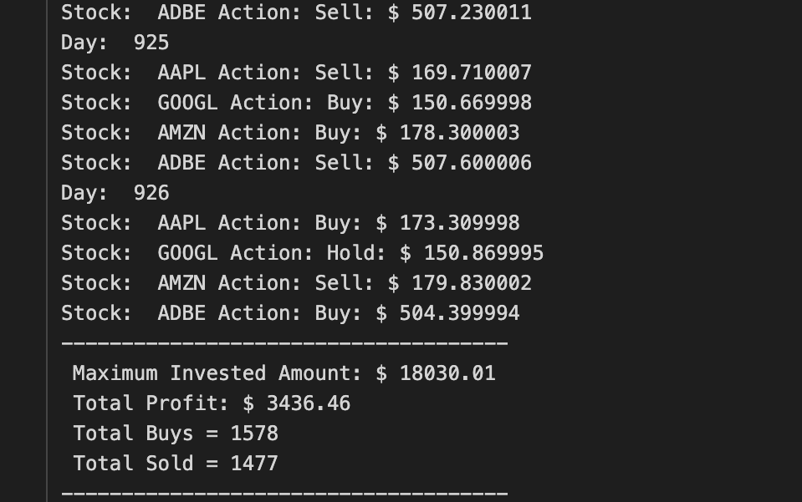
EVALUATION OUTPUT

Slide 13

FURTHER EXPLORATIONS
LSTM Predictions can be further improved using transformers on financial news and fundamental ratios.
DQN reward system can be further improved by incorporating investment cap, risk metrics, etc., for the selected stocks.
APIs can be integrated to feed the actions into an auto trader.
https://chisellabs.com/glossary/wp-content/uploads/2021/06/What-is-an-API.png

Slide 14
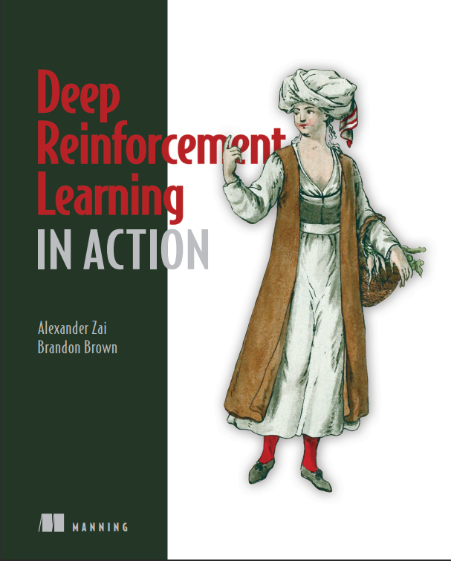
REFERENCES
FOR SLIDES & CODE:
Deep reinforcement Learning in Action by.Alexander Zai and Brandon Brown (2020)
CodeTrading YouTube Channel
Q-Trader Repo
DQN Repo
Cover Page of referenced book: Deep Reinforcement Learning in Action

Slide 15

Thank you
This Photo by Unknown Author is licensed under CC BY-NC

